Slide 1
Brain Tumor Image Classification Using CNN A Deep Learning Approach
By
Simmy xavier

Slide 2
Objectives
Objective: Develop a CNN model to classify brain MRI images into four categories:
Glioma
Meningioma
No Tumor
Pituitary
Goal: Assist in the early and accurate diagnosis of brain tumors

Slide 3
Dataset
Source: Kaggle
!kaggle datasets download -d masoudnickparvar/brain-tumor-mri-dataset
Content:
MRI images categorized into four classes
Divided into training and testing sets
Distribution:
Number of images per class
IMPORT ZIPFILE
import zipfile
with zipfile.ZipFile('brain-tumor-mri-dataset.zip', 'r') as zip_ref:
zip_ref.extractall('/data_dir/')

Slide 4
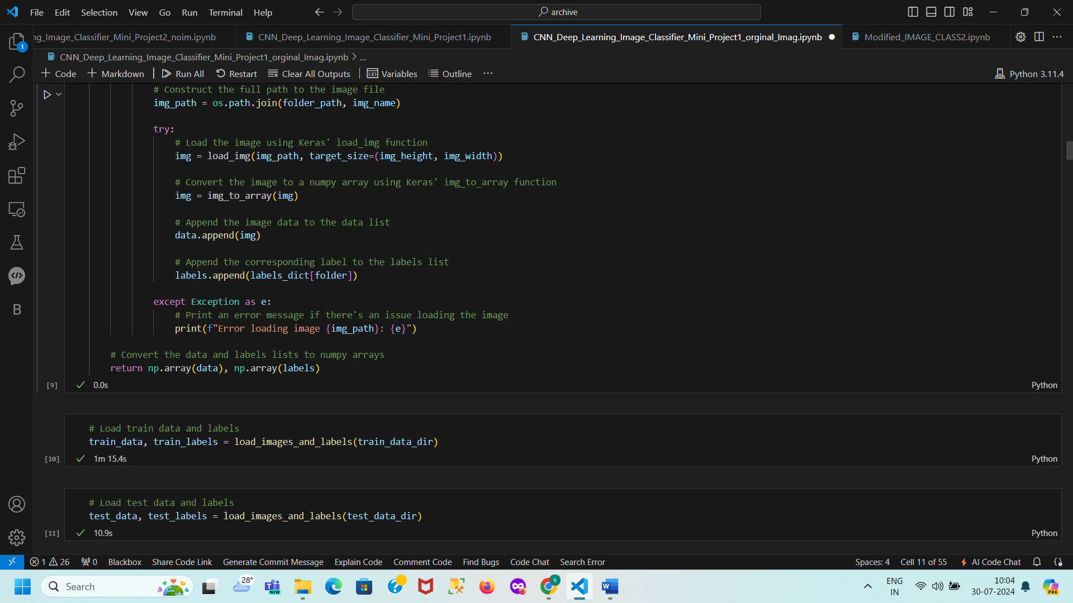
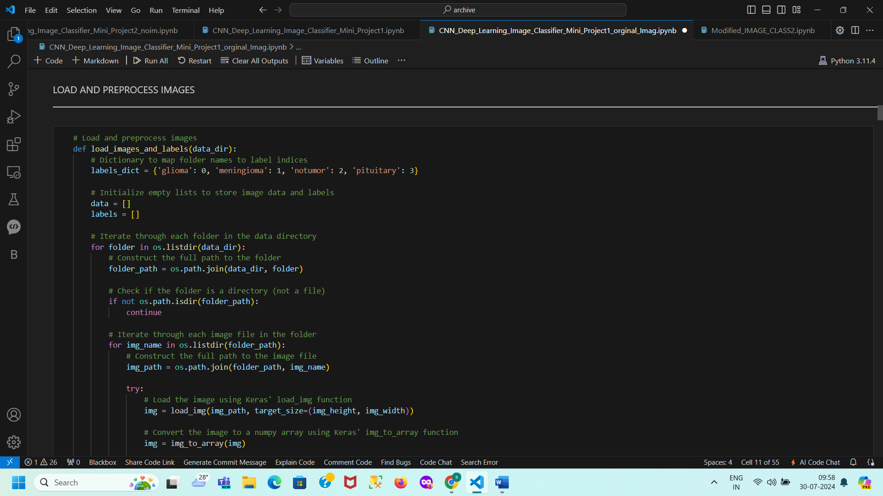
Load image
Data Preprocessing
Image Size: Resized to 224x224 pixels
Label Mapping: Folder names mapped to label indices

Slide 5
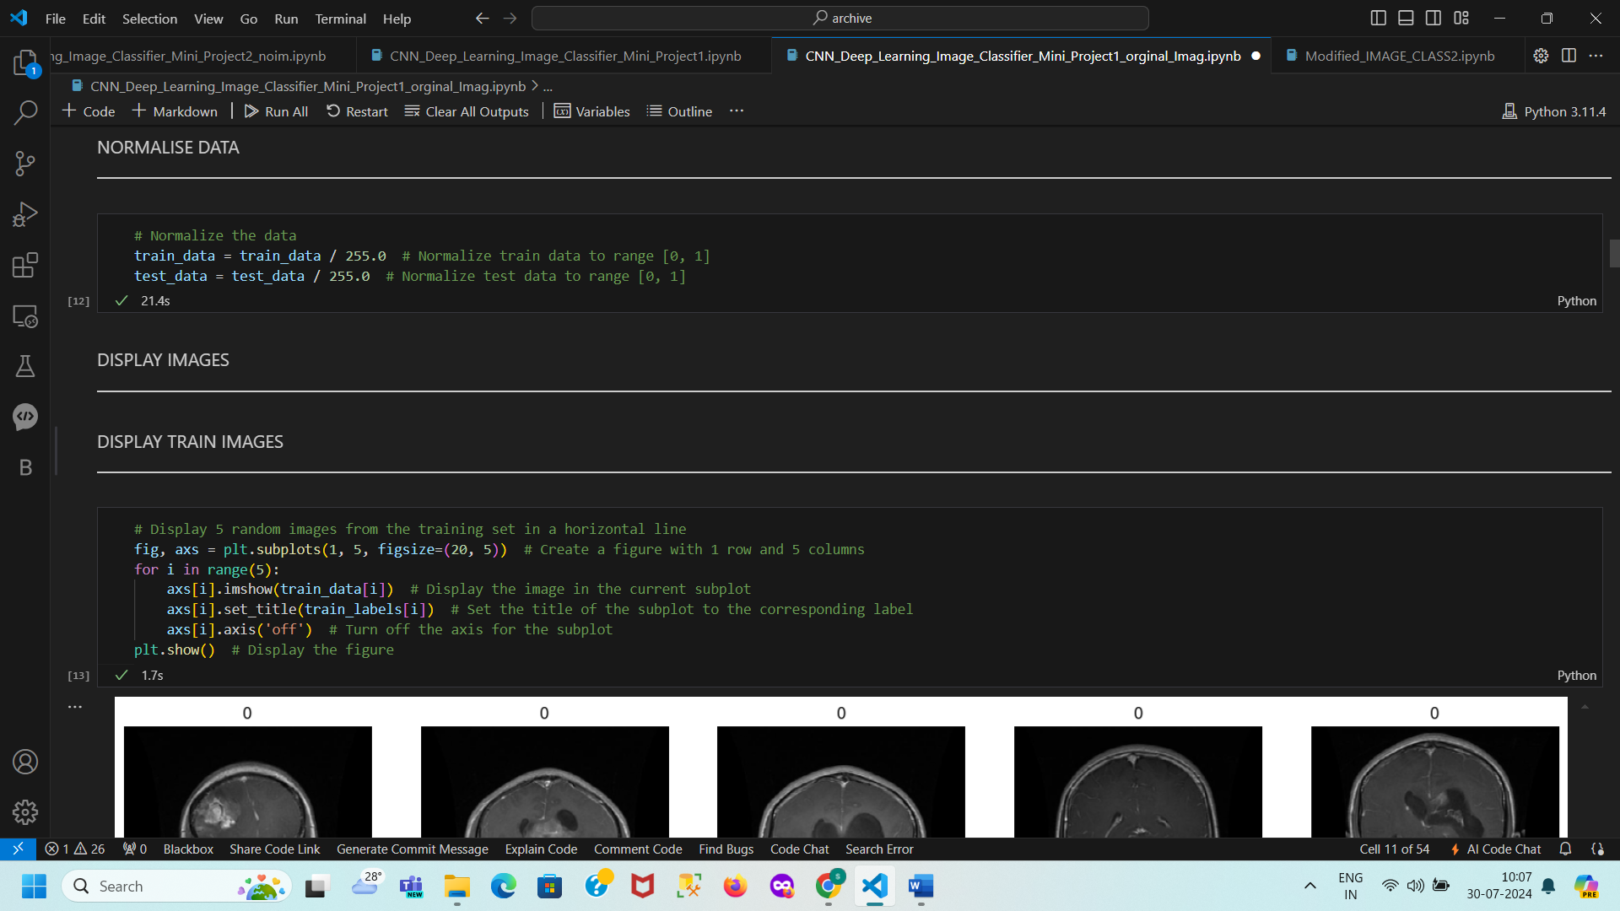
+-------------------+ +-------------------+ +-------------------+
| Start | | Initialize | | For Each Folder |
| | | Lists and | | in Data |
| | | Labels Dict | | Directory |
+-------------------+ +-------------------+ +-------------------+
| | |
v v v
+-------------------+ +-------------------+ +-------------------+
| For Each Image | | Construct Full | | Is Folder a Dir?|
| in Folder | | Path to Image | +-------------------+
+-------------------+ +-------------------+ / \
| | / \
v v v v
+-------------------+ +-------------------+ +-------------------+
| Load Image | | Append Data and| | Skip Non- |
| (Resize and | | Label to Lists | | Dir |
| Convert) | +-------------------+ +-------------------+
+-------------------+ | |
| v |
v +-------------------+ |
+-------------------+ | Handle Exceptions | |
| Convert Lists to | +-------------------+ |
| Numpy Arrays | | |
+-------------------+ v |
| +-------------------+ |
v | End | |
+-------------------+ +-------------------+ |
| End | |
+-------------------+ |
Normalization in Data Preprocessing
Consistent Input Scale
Ensures all features (e.g., pixel values) are on a similar scale (e.g., [0, 1]).
Improved Model Convergence
Enhances the efficiency and speed of gradient-based optimization algorithms.
Avoids Bias Toward Certain Features
Prevents features with larger ranges from disproportionately influencing the model.
Numerical Stability
Reduces risks of overflow or underflow in computations.
Consistent Input to Pre-trained Models
Aligns new data preprocessing with that used during model training.

Slide 6
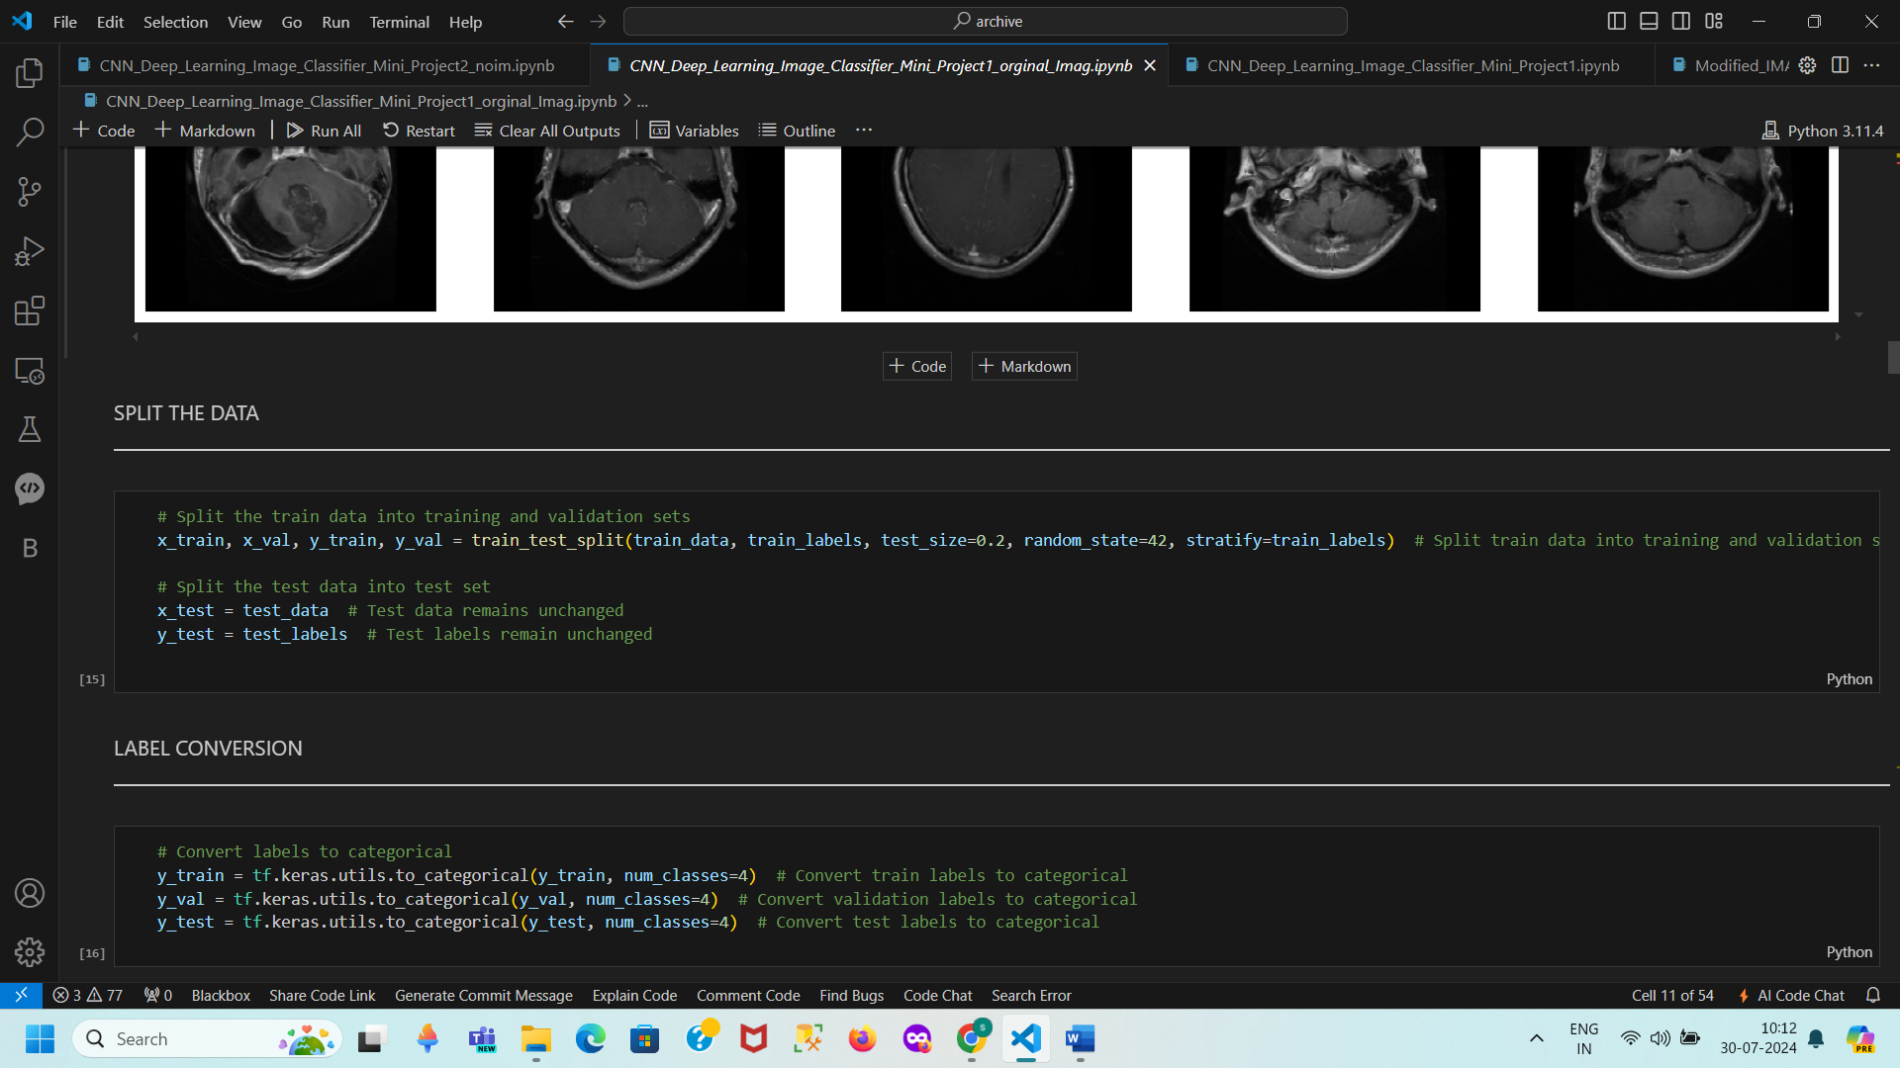
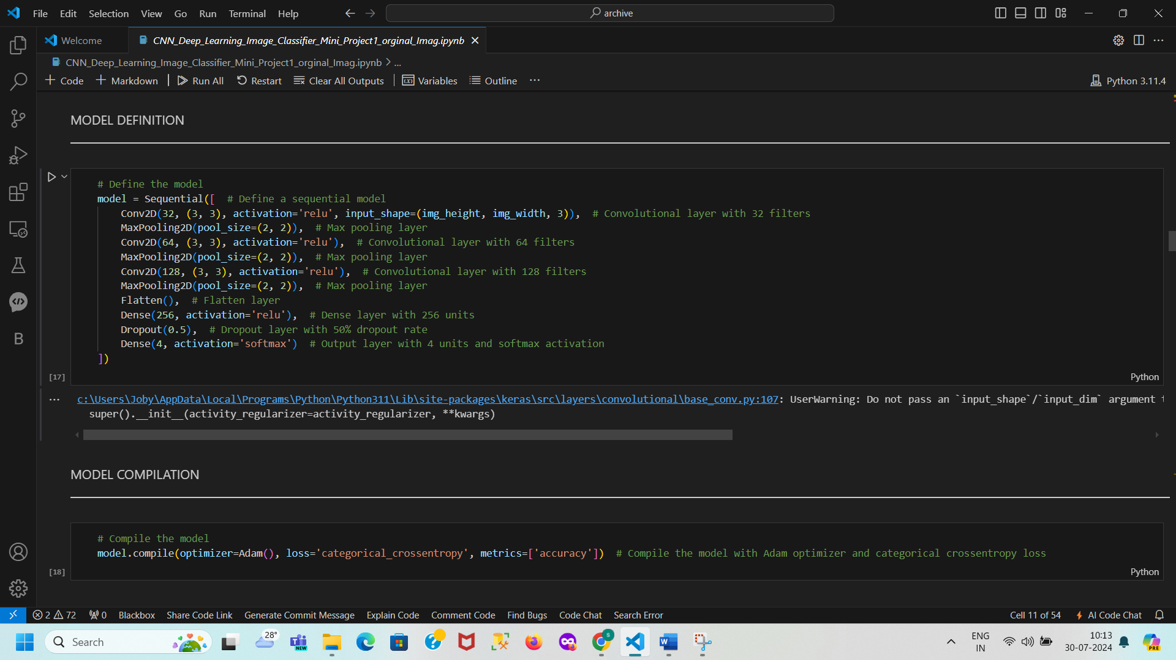
Model Architecture
Model Functionality Overview
Convolutional Layers:
32, 64, 128 filters: Extract low-level to high-level features
3x3 kernels: Capture spatial patterns
ReLU activation: Introduce non-linearity-Activation fn F(x) = max(0,x)
Range [0 to inf]-----positive-Real prob are non linear –capture complex pattern
Pooling Layers:
MaxPooling2D (2x2): Reduce spatial dimensions, retain important features
Reduces spatial dimensions (width and height) by taking the maximum value in each 2x2 region,
helps in downsampling and reducing computational load while preserving important features.
Flatten Layer:
Flatten: Convert 2D feature maps into a 1D vector for dense layers
Dense Layers:
256 units: Learn complex patterns with ReLU activation
4 units with Softmax: Output class probabilities for multi-class classification
Dropout Layer:
50% dropout: Prevent overfitting by randomly deactivating units
Overall Model Workflow:
Feature Extraction: Convolutional layers
Dimensionality Reduction: Pooling layers
Feature Transformation: Flatten and Dense layers
Regularization: Dropout
Classification: Softmax for final predictions
Splitting Training Data
Function: train_test_split from sklearn.model_selection
Training Data: x_train (features), y_train (labels)
Validation Data: x_val (features), y_val (labels)
Parameters:
test_size=0.2: 20% for validation
random_state=42: Reproducible results
stratify=train_labels: Balanced class distribution
Handling Test Data
Test Features: x_test (unchanged)
Test Labels: y_test (for evaluation)
Purpose:
Training and Validation: Fine-tune and validate the model
Testing: Evaluate final model performance

Slide 7
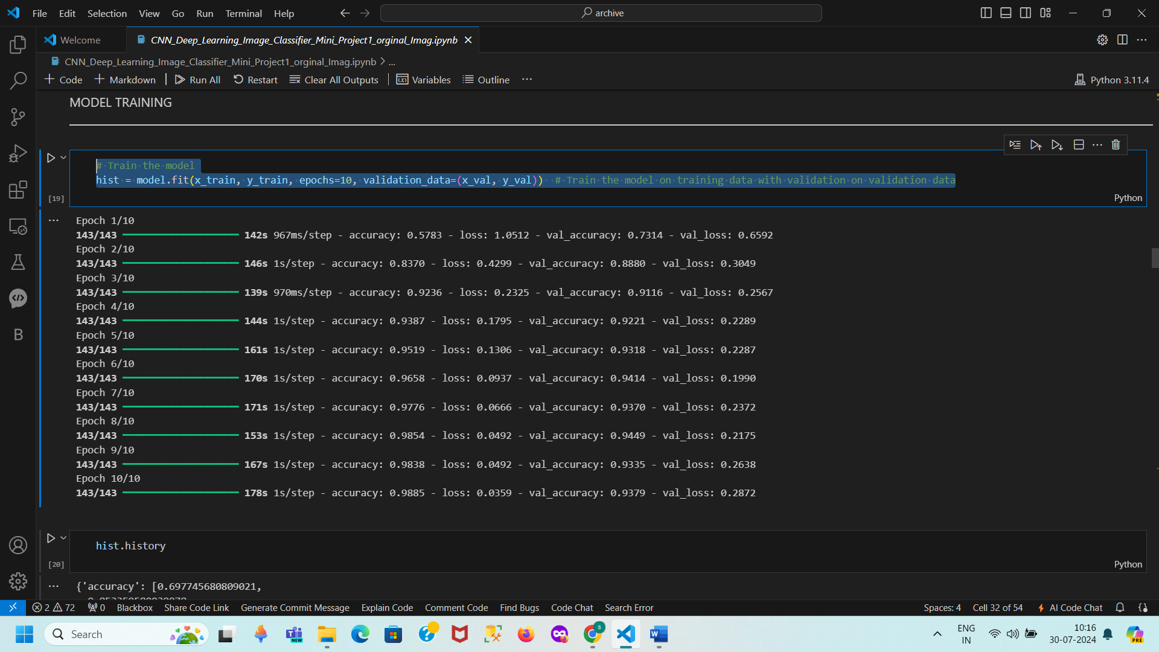
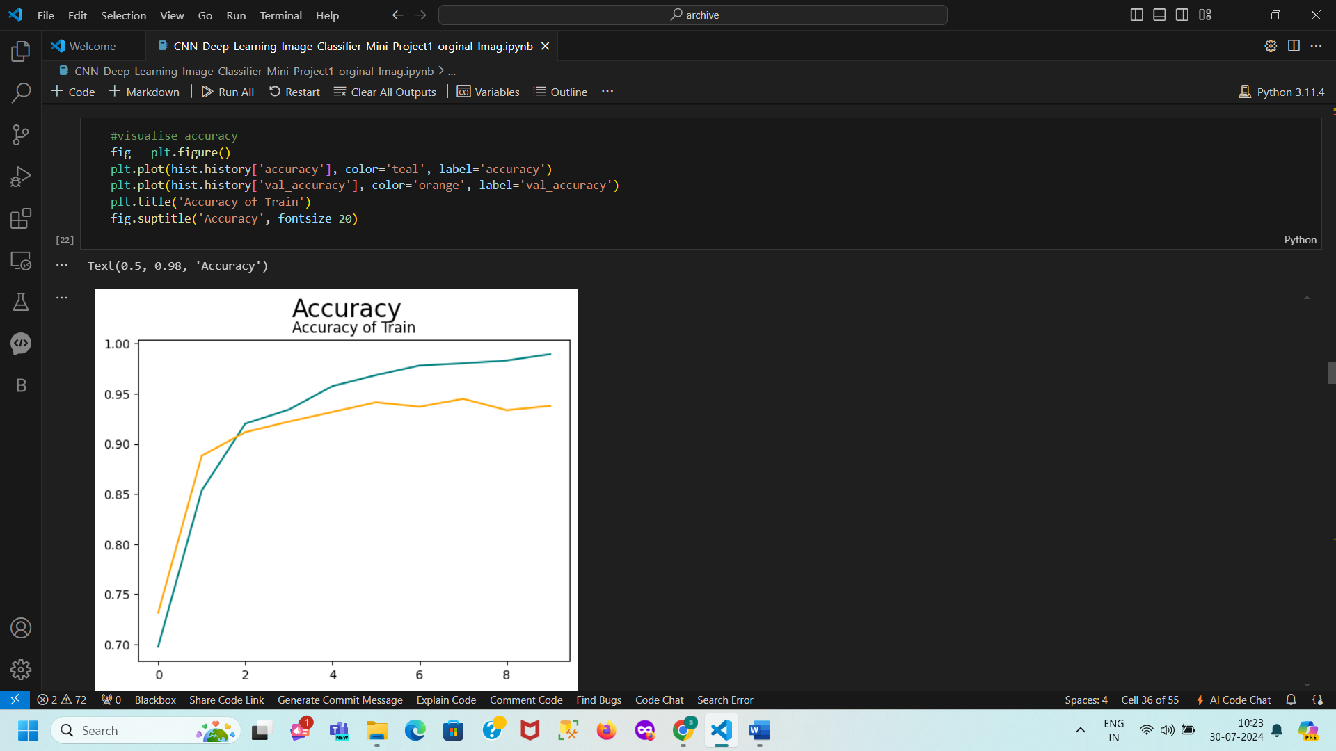
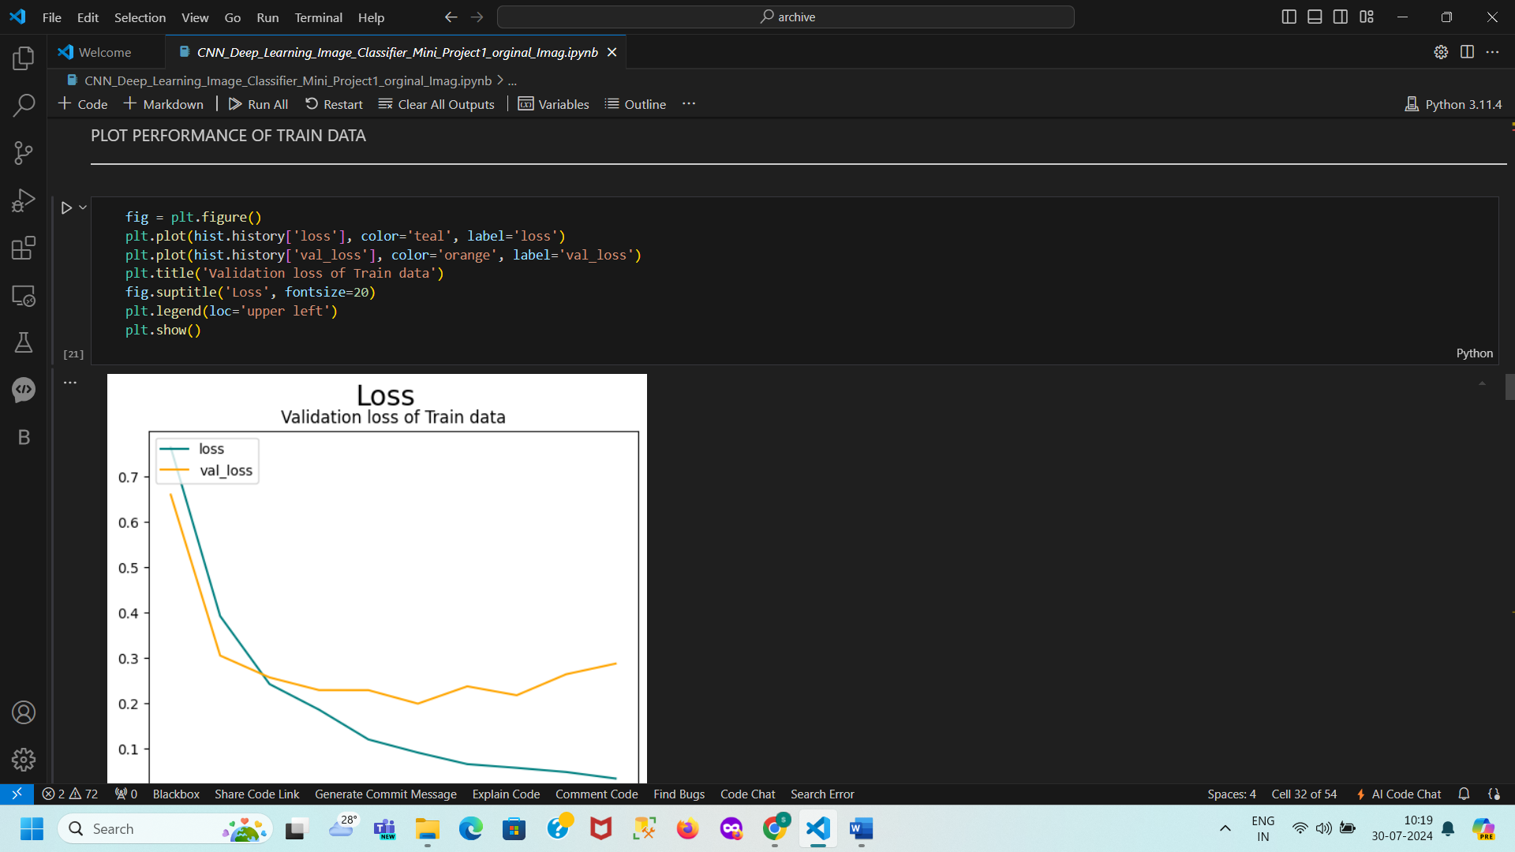
Train Model
Model Performance Summary
Effective Learning:
Decreasing Loss: Shows effective learning on training data.
Increasing Accuracy: Indicates good generalization to validation data.
No Overfitting:
Aligned Metrics: Close training and validation performance metrics suggest no overfitting.
Robust Fit:
Good Fit: Effective performance on both training and validation datasets.
Training the Model
Optimizer: Adam
Loss Function: Categorical cross-entropy
Training:
Epochs: 25
Batch Size: 32
Validation:
Split from training data
Validation Accuracy Plot Inference
Trend Observation:
Training Accuracy: Steady increase.
Validation Accuracy: Increases, then stabilizes.
Model Performance:
Training Accuracy: Shows effective learning.
Validation Accuracy: Consistently high.
Overfitting Check:
Minimal Gap: Between training and validation accuracy.
Convergence:
Accuracy Curves: Both converge, indicating a good fit.
[1m36/36[0m [32m━━━━━━━━━━━━━━━━━━━━[0m[37m[0m [1m17s[0m 366ms/step - accuracy: 0.9306 - loss: 0.3050Validation accuracy: 0.94[1m41/41[0m [32m━━━━━━━━━━━━━━━━━━━━[0m[37m[0m [1m13s[0m 315ms/step - accuracy: 0.9306 - loss: 0.2864Test accuracy: 0.95

Slide 8
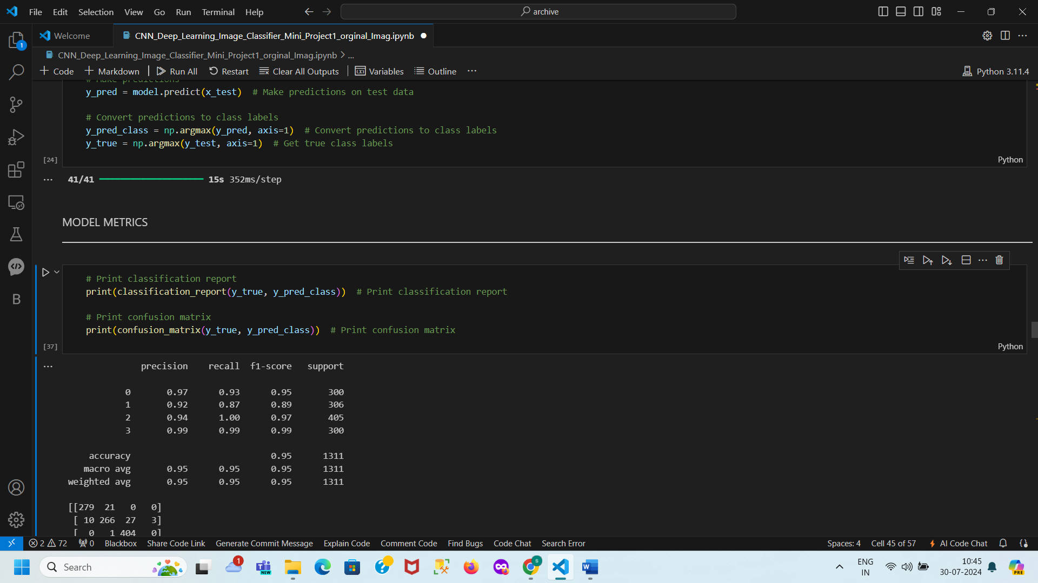
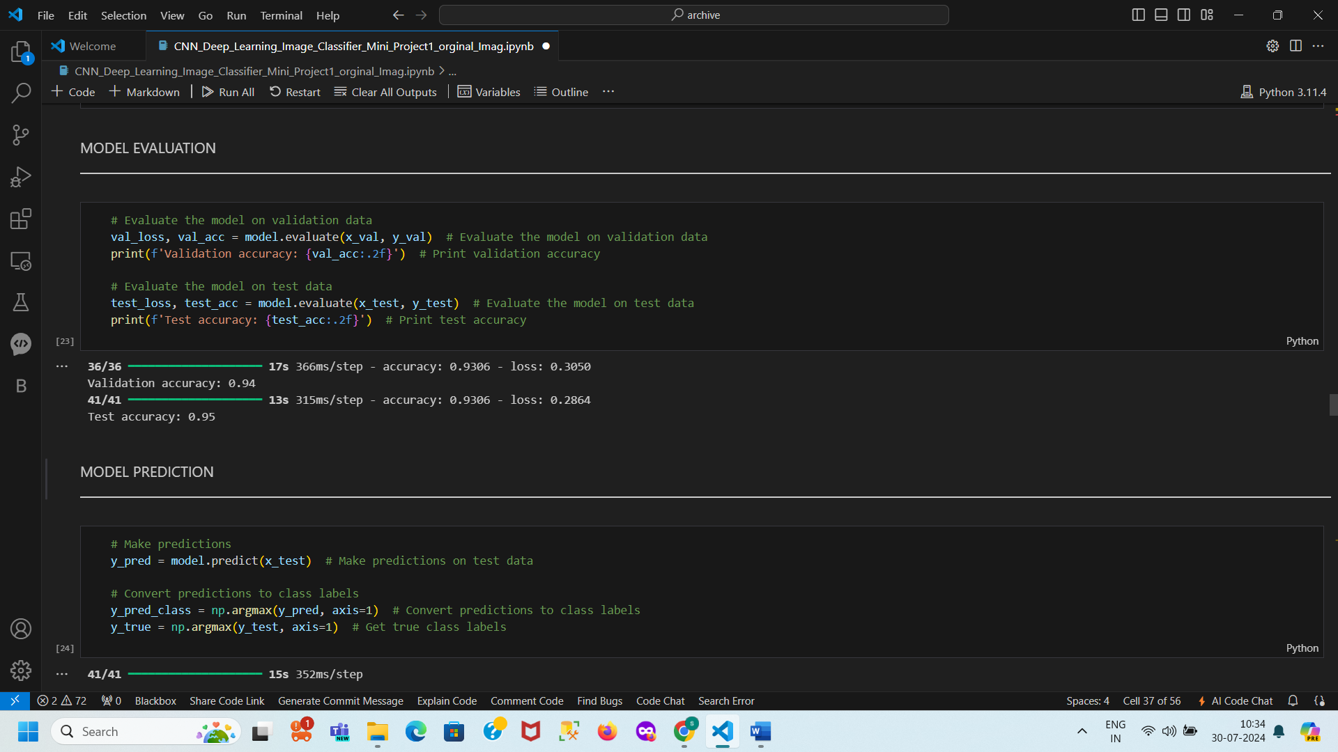
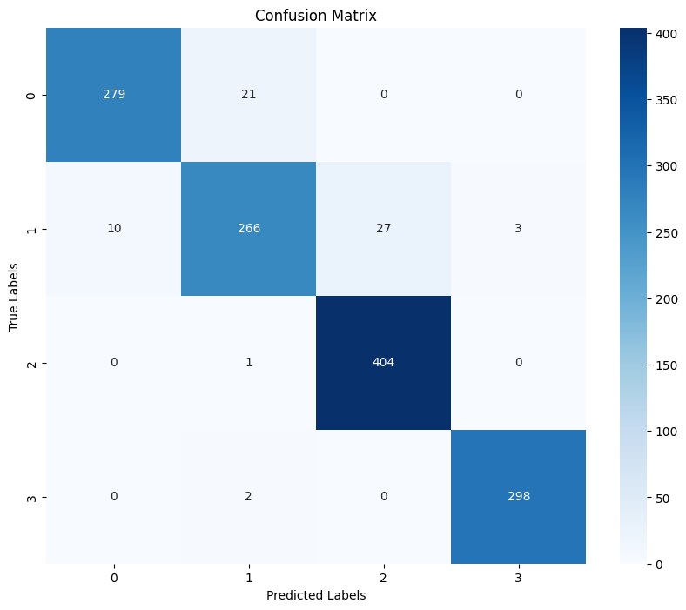
Model Evaluation
Metrics:
Accuracy
Confusion Matrix
Classification Report
Results:
Accuracy on test set:95 %
Accuracy of valildation: 94%
Performance for each class –
Class3: Exceptional performance with the highest precision, recall, and F1-Score.
Class2: : Perfect recall, indicating all instances of Class 2 are correctly identified. High precision and F1-Score.
Class1:Good performance with a lower recall compared to Class 0, suggesting some misclassification. Solid F1-Score of 0.89
Class0:Strong performance with high precision and recall, indicating accurate classification with minimal false positives and negatives.
Results: Confusion Matrix
True Positives: Diagonal values (279, 266, 404, 298) show correct classifications for each class.
False Negatives: Off-diagonal values in each row (e.g., 21 for Class 0) indicate instances misclassified as other classes.
False Positives: Off-diagonal values in each column (e.g., 10 for Class 1) represent instances incorrectly classified as that class.

Slide 9
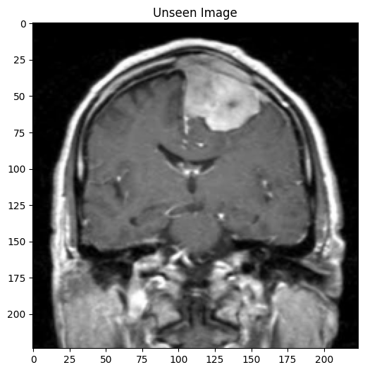
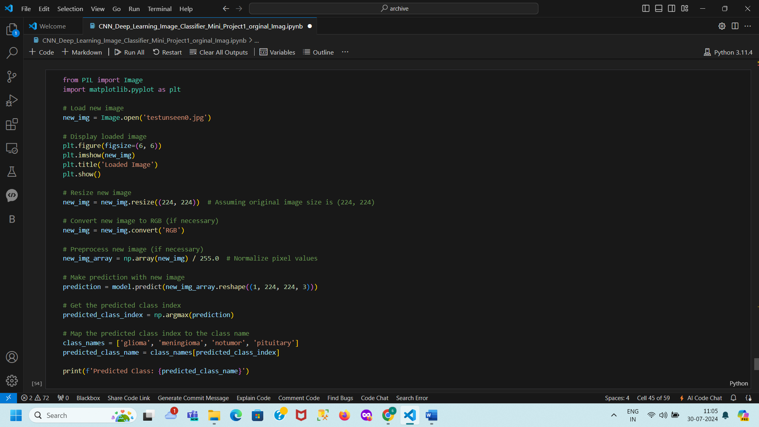
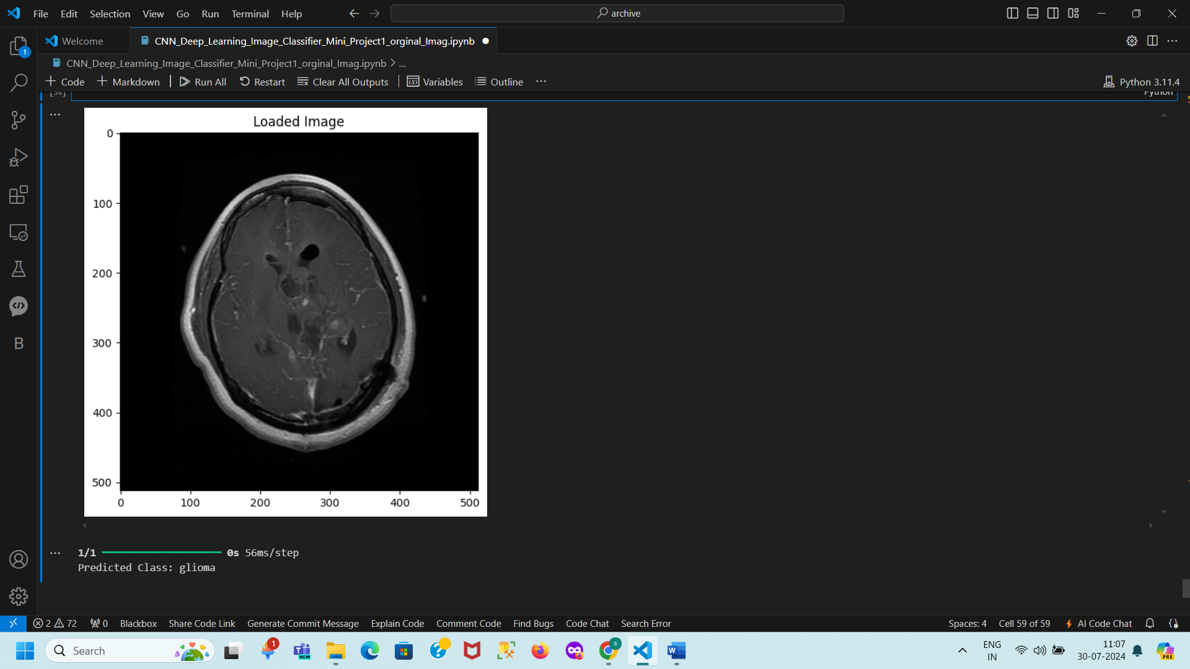
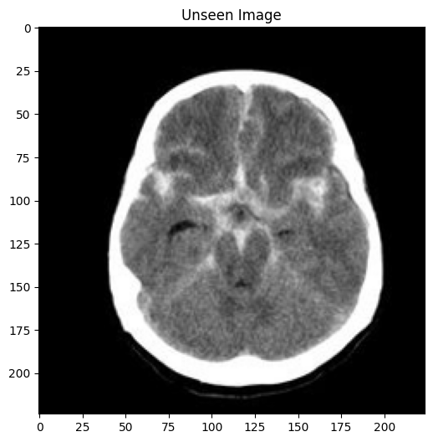
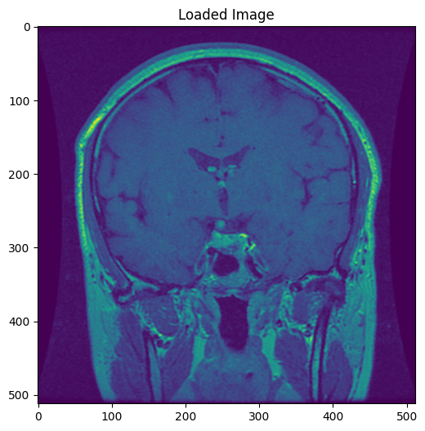
Prediction Unseen Data
[1m1/1[0m [32m━━━━━━━━━━━━━━━━━━━━[0m[37m[0m [1m0s[0m 88ms/stepPredicted Class for testunseen1.jpg: meningioma
[1m1/1[0m [32m━━━━━━━━━━━━━━━━━━━━[0m[37m[0m [1m0s[0m 33ms/stepPredicted Class: pituitary
[1m1/1[0m [32m━━━━━━━━━━━━━━━━━━━━[0m[37m[0m [1m0s[0m 79ms/stepPredicted Class for testunseen2.jpg: notumor

Slide 10
Insights and Observations
Class Imbalance: Address with data augmentation
Overfitting: Prevented with Dropout layers
Model Performance: Robust, potential for practical application

Slide 11
Conclusion
Summary: Effective classification of brain MRI images
Impact: Assist in early and accurate diagnosis
Future Work: Explore advanced architectures, larger datasets

